Slide 1

Identification
(User Authentication)

Slide 2
Model I
Alice client ; Bob server
Alice wishes to
Access resource
Obtain service
Bob grants access to clients
After identification / authentication

Slide 3
Model II
Bob asks one of:
Who are you? (Prove that you are Alice)
Who the **** is Alice?
Initial identification
Alice authenticates identity
Initial identification
Given key material (after initial identification)

Slide 4
Adversary
Eve attempts to
Impersonate Alice
Eve may be able to
Eavesdrop
Actively control Alice-Bob link
Extract “limited” information from Alice & Bob

Slide 5
Scenarios

Slide 6
Identification Scenarios
Scenarios differ by
Location – local/remote authentication
Identified entity – human / device
Authentication authorities
Single authority vs. multiple authorities
Operational server & authentication server
Joint or separate

Slide 7

Local Identification
Physical interface
Device
Human user
Examples:
Laptop, smartphone, ATM

Slide 8




Remote Authentication
Human user
Server
device
Network
Examples:
Web sites, telephony network

Slide 9
Single Authority
Key Manager
Password
Human user
Identities, keys
Key
Server
device
Examples:
organizational networks,
service providers,
Users authenticating to web sites

Slide 10
Multiple Authorities
Key Manager₁
⋅⋅⋅
Key Manager_{n}
Identities, keys
Identities, keys
Server
device
Examples:
Web sites authenticating to browsers

Slide 11
Split Servers
Authentication Server
Human user
Authentication request
Auth. protocol
device
Network
Auth. request
Examples:
AAA servers
Roaming in mobile networks
Operational Server

Slide 12
“physical World” Issues

Slide 13
Initial Authentication I
How does Alice initially convince anyone that she’s Alice?
Often, “real-world” authentication
ID card, driver’s license etc.
Errors due to human factor are numerous
Examples
The Microsoft-Verisign fiasco
Example – phishing

Slide 14
Stealing Credentials
Authentication mechanisms
Identify possession of key
Do not authenticate “real” identity
Stolen credentials ➔ ID theft
Examples
Stolen/forged documents (e.g. passports)
Stolen credit-card numbers

Slide 15
Passwords

Slide 16
Model
Server wants to identify (human) user
User registers password with server
User memorizes password (or uses post-it)
Password / f(password) stored in server database
Adversary
Wishes to impersonate user

Slide 17
Adversary’s Options I
Monitor/control user-server communication
Guess the password
Make a guess, send to server, observe result
Take advantage of password reuse for different services
Same users, same e-mail addresses, same passwords

Slide 18
Adversary’s Options II
Get password from user
Get password from server database

Slide 19
Basic Password Protocol
Server
Client
Username: U
Password: P
Username | Password
U₁ | P₁
U₂ | P₂
… | …
U_{n} | P_{n}
(U,P)
Search (U,P)
Access granted

Slide 20
Pros and Cons
Main advantage
Simple implementation
Main problem
Eavesdropping ➔impersonation

Slide 21
Challenge-Response
Server
Client
Username: U
Password: P
Username | Password
U₁ | P₁
U₂ | P₂
… | …
U_{n} | P_{n}
U
Search U
Random challenge r
Response: MAC_{k}(r)
Access granted

Slide 22
Weak Passwords
Weak password
Can be easily guessed
Part of a known dictionary of passwords
A common password with predictable changes
Name + year
Single word and mirror image (qwertyytrewq)
Changes E to 3, o to 0 etc.
Challenge-response with weak password is insecure

Slide 23
Server Storage
Password database ➔ tempting target
Storage options for passwords
Plaintext
Encrypted
Require key for decryption during authentication
One-way hash of password
Inapplicable for challenge-response

Slide 24
Guessing Attacks I
Input: database of hashed passwords
Output: plaintext passwords
Attack options
Invert hash: very difficult
Guess password: easier
Offline attack
Preprocessing independent of hashed passwords

Slide 25
Guessing Attacks II
Password space – N
Number of hashed passwords – m
Option 1: brute force search of password space
Time O(N+m), memory – O(m)
Option 2: Offline brute force and store table of all possible hashes
Offline time O(n), Memory – O(N)
Online time – O(m)

Slide 26
Hash Chains I [Hellman]
Option 3: hash chains, a method for time-memory tradeoff in password cracking
Offline time – O(N)
Memory – O(N/k), Online time – O(k)
Some parameter k (e.g. k=N^{1/2})
Space of hashes – S={0,1}^{s} for s=160/256/512 etc.
Space of passwords – P={a,…,z,A,…,Z,0,…,9….}^{l} for relatively small l

Slide 27
Hash Chains II
Hash function h:P→S
Defined by server
Reduction function r:S→P
Defined by attacker to be close to “uniform”
Example:
Translate each of the first l bytes in a hash to a legal character for a password.

Slide 28
Hash Chains Offline
k-th password
hash
Reduce
hash
Avi1985
0x13A2…
V3sf465
⋅⋅⋅
Tr0ubador&3
hash
Reduce
hash
GabDeb
0x9C02…
13hg4Y
⋅⋅⋅
iLUVm0mmy
⋅⋅⋅
hash
Reduce
hash
Admin
0x1A3F…
Hello
⋅⋅⋅
1elections
Store first and last password in each row O(N/k)

Slide 29
Hash Chains Online
Desired password
Input hash
hash
Reduce
hash
pass₁
hash₁
pass₂
hash₂
⋅⋅⋅
pass_{k}
Algorithm:
Reduce and hash from input hash
until pass=pass_{k}
Reduce and hash from pass₁
until hash=input hash
Previous pass is correct

Slide 30
Hash Chains Problem
The chains may collide and merge
Preprocessing stage not aware of merge
➔
Coverage of password space is far from complete
Online mistakes in matching
Attacker can improve search by extending searched chain
Attacker can improve coverage by rainbow tables

Slide 31
Rainbow Tables
Hash chains with m reduction functions
reduce₁,…,reduce_{m}
Chain operations
Hash, reduce₁, hash, reduce₂,…,reduce_{m}, hash, reduce₁,…
Merge occurs only if collisions on same reduction function
Better in practice than regular hash chains

Slide 32
Hash Correctly & Salt
Server stores hash of password and other data
Hash computation “long time”, e.g. 100 ms
Increases time of testing guesses
Additional stored data – a “salt”.
Server stores <h(pwd,salt),salt>
Online authentication – server sends salt to client
Breaks preprocessing attacks and slows down password guessing attacks

Slide 33
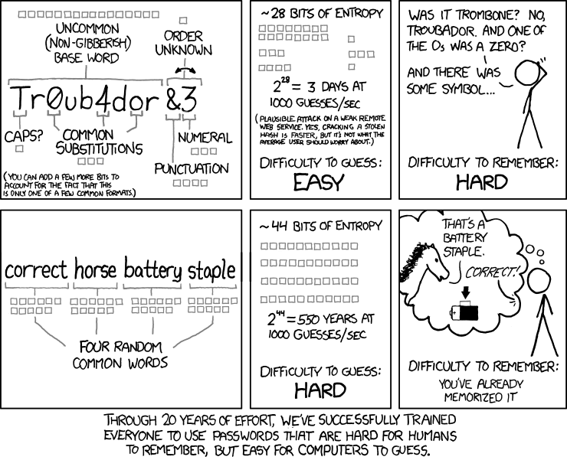
Hot to Choose a PWD

